Slide 1
gpd;dq;fs;
juk; 07
Prepared by : Miss.S.M.J.Perera
Mn/Thalaimannar Pier G.T.M.S

Slide 2
epow;wpa gFjp KO cUtpd; vd;d gpd;dk;?
$$\frac{2}{5}$$
$$\frac{3}{6}$$
$$\frac{5}{8}$$
$$\frac{1}{4}$$

Slide 3
tFg;nghd;wpYs;s 25 khztu;fspy; 13 Ngu; ngz; gps;isfshtu;.
tFg;gpYs;s ngz; gps;isfspd; vz;zpf;ifia nkhj;j khztu;fspd; gpd;dkhf vOJf.
$$\frac{13}{25}$$
tFg;gpYs;s Mz; gps;isfspd; vz;zpf;ifia nkhj;j khztu;fspd; gpd;dkhf vOJf.
$$\frac{12}{25}$$

Slide 4
$$\frac{2}{3}$$
njhFjp vz;
gFjp vz;

Slide 5
Kiwikg;gpd;dq;fs;
gFjpnaz;iz tpl njhFjpnaz; rpwpajhf cs;s gpd;dq;fs;.
cjhuzk; :
$\frac{3}{5}$, $\frac{2}{3}$, $\frac{6}{10}$, $\frac{8}{9}$
myFg;gpd;dq;fs;
njhFjpnaz; 1 MfTs;s gpd;dq;fs;.
cjhuzk; :
$\frac{1}{3}$, $\frac{1}{8}$, $\frac{1}{100}$, $\frac{1}{19}$

Slide 6
rktYg;gpd;dk;
NtWgl;l gFjpnaz;izAk; NtWgl;l njhFjpnaz;izAk; nfhz;lNghJk;> xNu mstpid fhl;Lk; gpd;dq;fs;.
$$\frac{1}{2}$$
$$\frac{2}{4}$$
$\frac{1}{2}$ = $\frac{2}{4}$ = $\frac{3}{6}$ = $\frac{4}{8}$
$$\frac{3}{6}$$
$$\frac{4}{8}$$

Slide 7
rktYg; gpd;dj;ij ngWtjw;F
Xu; vz;zpd; …………………. > ………………….. ,uz;ilAk; G+r;rpaky;yhj KO vz; xd;wpdhy; ………………… %yk; my;yJ ………………….%yk; jug;gl;l gpd;dj;jpw;Fupa rktYg;gpd;dq;fs; ngwg;gLk;.
njhFjpnaz;
gFjpnaz;
ngUf;Ftjd;
tFg;gjd;
cjhuzk; :
$\frac{2 X 5}{3 X 5}$= $\frac{10}{15}$ ,
$\frac{2 X 50}{3 X 50}$ = $\frac{100}{150}$
$\frac{2}{3}$ = $\frac{10}{15}$ = $\frac{100}{150}$
$\frac{20 ÷ 2}{60 ÷ 2}$ = $\frac{10}{30}$ ,
$$\frac{20 ÷5}{60 ÷5}= \frac{4}{12}$$
$$\frac{20}{60}= \frac{10}{30}=\frac{4}{12}$$

Slide 8
tpdhf;fs;
myFg; gpd;dq;fs; 5 vOJf.
Kiwikg; gpd;dq;fs; 5 vOJf.
$\frac{6}{8}$ ,w;F rktYg;gpd;dk; 3 vOJf.
$\frac{4}{6}$ ,w;F gFjpnaz; 3MfTs;s rktYg;gpd;dj;ij vOJf.
25 Gs;spfs; toq;fg;gl;l guPl;ir xd;wpy; wPw;uh 18 Gs;spfs; ngw;whs;. wPw;uh ngw;w Gs;spfis nkhj;j Gs;spfspd; gpd;dkhf vOJf.

Slide 9
+
1
+
$$\frac{1}{2}$$
=
$$1 \frac{1}{2}$$
,t;thW KO vz;Zk; gpd;dKk; Nru;e;j vz;
fyg;ngz;zhFk;
,J xd;Wld; ,uz;by; xd;W vd thrpf;fg;gLk;.

Slide 10
fyg;ngz;
thrpf;Fk; Kiw
$2 \frac{3}{5}$
,uz;Lld; Ie;jpy; %d;W
$$6 \frac{2}{7}$$
MWld; Vopy; ,uz;L
$$3 \frac{5}{10}$$
%d;Wld; gj;jpy; Ie;J

Slide 11
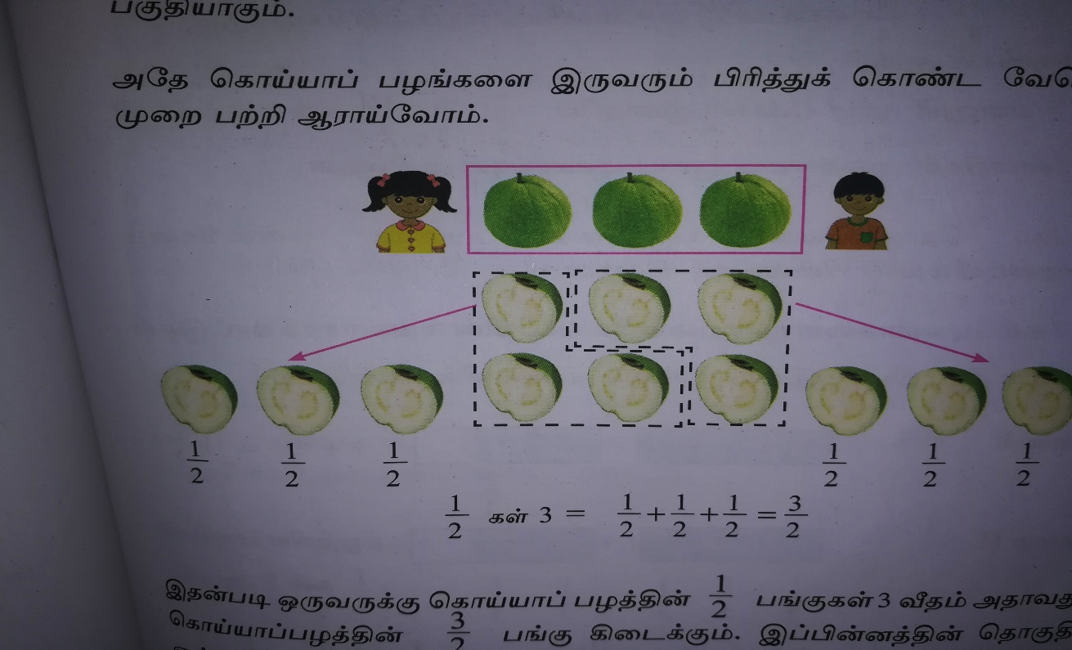
nraw;ghL

Slide 12
Kiwikapy;yhg;gpd;dk;
gpd;dnkhd;wpd; njhFjpnaz; gFjpnaz;Zf;Fr; rkdhf my;yJ gFjpnaz;zpYk; ngupjhf ,Ug;gpd; mJ Kiwikapy;yhg; gpd;dkhFk;.
cjhuzk; :
$\frac{3}{2}$ , $\frac{7}{5}$ , $\frac{9}{4}$ , $\frac{11}{3}$

Slide 13
fyg;G vz;fis Kiwikapy;yhg; gpd;dq;fshf fhl;ly;
Kiw 1
1 + $\frac{2}{3}$ = $1 \frac{2}{3}$
1
$$\frac{2}{3}$$
$\frac{1}{3}$ + $\frac{1}{3}$ + $\frac{1}{3}$ + $\frac{1}{3}$ + $\frac{1}{3}$ = $\frac{5}{3}$
$$\frac{1}{3}$$
$$\frac{1}{3}$$
$$\frac{1}{3}$$
$$\frac{1}{3}$$
$$\frac{1}{3}$$
$1 \frac{2}{3}$ = $\frac{5}{3}$

Slide 14
cjhuzk; 2
cjhuzk; 1
$$2 \frac{3}{4}$$
$$\frac{3}{4}$$
=
2
+
$$1\frac{3}{5}$$
=
1
+
$$\frac{3}{5}$$
$$\frac{3}{4}$$
=
1 + 1
+
$$\frac{5}{5}$$
$$\frac{3}{5}$$
=
+
$$\frac{4}{4}$$
$$\frac{4}{4}$$
$$\frac{3}{4}$$
=
+
+
$$\frac{8}{5}$$
=
$$\frac{11}{4}$$
=

Slide 15
tpdhf;fs;
gpd;tUk; fyg;ngz;fis Kiwikapy;yhg;gpd;dkhf jUf
1) $1 \frac{3}{4}$
2) $2 \frac{1}{5}$
3) $4 \frac{2}{3}$
1 + $\frac{3}{4}$ = $\frac{4}{4}$ + $\frac{3 }{4}$ = $\frac{7}{4}$
2 + $\frac{1}{5}$ = 1 + 1 + $\frac{1}{5}$
= $\frac{5}{5}$ + $\frac{5}{5}$ + $\frac{1}{5}$ = $\frac{11}{5}$
4 + $\frac{2}{3}$ = 1 + 1 + 1 + 1 + $\frac{2}{3}$
= $\frac{3}{3}$ + $\frac{3}{3}$ + $\frac{3}{3}$ + $\frac{3}{3}$ + $\frac{2}{3}$ = $\frac{14}{3}$

Slide 16
fyg;G vz;fis Kiwikapy;yhg; gpd;dq;fshf fhl;ly;
Kiw 2
fyg;G vz;Zf;Fr; rkdhd Kiwikapy;yhg;gpd;dj;jpd; njhFjpnaz;iz ngwy;
fyg;G vz;zpYs;s KO vz;iz gpd;dj;jpd; gFjpnaz;zpdhy; ngUf;fp> gpd;dj;jpd; njhFjpnaz;Zld; $l;ly;.
fyg;G vz;Zf;Fr; rkdhd Kiwikapy;yhg;gpd;dj;jpd; gFjpnaz;iz ngwy;
fyg;G vz;zpYs;s gpd;dj;jpd; gFjpNa mjw;F rkdhd Kiwikapy;yhg;gpd;dj;jpd; gFjpahFk;.

Slide 17
fyg;G vz;Zf;Fr; rkdhd Kiwikapy;yhg;gpd;dj;jpd; njhFjpnaz;iz ngwy;
+
$$1 \frac{3}{5}$$
X
5 X 1
+ 3
= 8

Slide 18
fyg;ngz;
Kiwikapy;yhg;gpd;dk;
$$3 \frac{2}{6}$$
njhFjp 6 x 3 + 2 = 20
$$\frac{20}{6}$$
gFjp 6
$$2 \frac{4}{5}$$
njhFjp 5 x 2 + 4 = 14
$$\frac{14}{5}$$
gFjp 5
$$5 \frac{7}{8}$$
njhFjp 8 x 5 + 7 = 47
$$\frac{47}{8}$$
gFjp 8

Slide 19
Kiwikapy;yhg; gpd;dq;fis fyg;ngz;fshf vOJjy;
Kiw 1
$$\frac{5}{3}$$
= $\frac{3 + 2}{3}$
= $\frac{3}{3}$ + $\frac{2}{3}$
= 1 + $\frac{2}{3}$
= $1 \frac{2}{3}$

Slide 20
cjhuzk; 2
$$\frac{17}{10}$$
= $\frac{10 + 7}{10}$
= $\frac{10}{10}$ + $\frac{7}{10}$
= 1 + $\frac{7}{10}$
= $1 \frac{7}{10}$

Slide 21
cjhuzk; 3
$$\frac{17}{4}$$
= $\frac{4 + 4 + 4 + 4 + 1}{4}$
= $\frac{4}{4}$ + $\frac{4}{4}$ + $\frac{4}{4}$ + $\frac{4}{4}$ + $\frac{1}{4}$
= 1+ 1 + 1 + 1 + $\frac{1}{4}$
= 4$\frac{1}{4}$

Slide 22
Kiw 2
$\frac{5}{3}$ = 5 ÷ 3
<T fyg;ngz;zpd; KOvz;
kPjp Kiwikg;gpd;dj;jpd; njhFjpnaz;
1
<T
3
5
= $1 \frac{2}{3}$
3
2
2
kPjp

Slide 23
cjhuzk; 2
$\frac{17}{4}$ = 17 ÷ 4
<T fyg;ngz;zpd; KOvz;
kPjp Kiwikg;gpd;dj;jpd; njhFjpnaz;
4
<T
4
17
= 4$\frac{1}{4}$
16
1
kPjp

Slide 24
tpdhf;fs;
$$1 \frac{2}{6}$$
$$3 \frac{1}{3}$$
$$4\frac{1}{2}$$
$$10 \frac{4}{9}$$
gpd;tUk; Kiwapy;yhg; gpd;dq;fis fyg;G vz;zhfj; jUf
1) $\frac{8}{6}$
2) $\frac{10}{3}$
3) $\frac{9}{2}$
4) $\frac{94}{9}$

Slide 25
gpd;dq;fis xg;gply;
njhFjpnaz; rkdhd gpd;dq;fis xg;gply;
cjhuzk; 1
$$\frac{1}{3}$$
$$\frac{1}{2}$$
>
$$\frac{1}{3}$$
$$\frac{1}{2}$$
cjhuzk; 2
$$\frac{3}{7}$$
$$\frac{3}{5}$$
$$\frac{3}{7}$$
>
$$\frac{3}{5}$$
njhFjpnaz; rkdhd gpd;dq;fspy; gFjpnaz; rpwpjhf cs;s gpd;dk; ……………….gpd;dk; MFk;.
ngupa

Slide 26
gFjpnaz; rkdhd gpd;dq;fis xg;gply;
cjhuzk; 1
$$\frac{2}{3}$$
>
$$\frac{1}{3}$$
$$\frac{2}{3}$$
$$\frac{1}{3}$$
cjhuzk; 2
$$\frac{3}{7}$$
$$\frac{5}{7}$$
$$\frac{3}{7}$$
>
$$\frac{5}{7}$$
gFjpnaz; rkdhd gpd;dq;fspy; njhFjpnaz; ngupjhf cs;s gpd;dk; ……………….gpd;dk; MFk;.
ngupa

Slide 27
gFjpnaz;> njhFjpnaz; ,uz;Lk; rkdw;w gpd;dq;fis xg;gply;
rktYg;gpd;dq;fis gad;gLj;jp gFjpfis rkg;gLj;jp ngupa gpd;dj;ij mwpe;J nfhs;syhk;.
cjhuzk; 1
cjhuzk; 2
$$\frac{5}{3}$$
>
>
$$\frac{5}{3}$$
$$\frac{7}{6}$$
$$\frac{3}{8}$$
$$\frac{1}{2}$$
$$\frac{5 X 2}{3 X 2}$$
$$\frac{7}{6}$$
$$\frac{3}{8}$$
$$\frac{1 X 4}{2 X 4}$$
$$\frac{10}{6}$$
>
$$\frac{3}{8}$$
$$\frac{7}{6}$$
>
$$\frac{4}{8}$$

Slide 28
cjhuzk; 3
$$\frac{8}{12}$$
>
$$\frac{5}{8}$$
2
12 , 8
2
6 , 8
2
3 , 4
$$\frac{8 X 4}{12 X 4}$$
$$\frac{5 X 6}{8 X 6}$$
2
3 , 2
3
3 , 1
1 , 1
$$\frac{32}{48}$$
>
$$\frac{30}{48}$$
ngh.k.rp = 2 x 2 x 2 x 2 x 3 =
48

Slide 29
ngupa gpd;dj;ij Rw;wp tl;lkpLf
$\frac{2}{5}$ , $\frac{4}{5}$
$\frac{2}{8}$ , $\frac{1}{2}$
$\frac{5}{6}$ , $\frac{2}{3}$
$\frac{6}{8}$ , $\frac{1}{3}$
$\frac{2}{9}$ , $\frac{3}{4}$

Slide 30
fyg;G vz;fis xg;gpLjy;
KOntz; rkdw;w fyg;ngz;fis xg;gply;
$$2\frac{3}{4}$$
<
$$5\frac{1}{2}$$
$$7\frac{3}{5}$$
<
$$4\frac{3}{5}$$
$$8\frac{5}{6}$$
<
$$7\frac{1}{3}$$
$$3\frac{1}{2}$$
<
$$6\frac{1}{4}$$
KO vz;fs; rkdw;wit vdpd; mtw;wpy; ngupa Kontz;iz nfhz;l fyg;ngz; ……………. fyg;ngz;zhFk;.
ngupa

Slide 31
KOntz; rkdhd fyg;ngz;fis xg;gply;
Kiw 1
gpd;dg;gFjpia xg;gpLtjd; %yk; ngupa fyg;ngz;iz ,dq;fhzyhk;.
$$5 \frac{2}{3}$$
<
$$5 \frac{1}{3}$$
$$3 \frac{1}{2}$$
<
$$3 \frac{5}{6}$$
$$\frac{2}{3}$$
<
$$\frac{1}{3}$$
$$\frac{1}{2}$$
$$\frac{X 3}{X 3}$$
$$\frac{5}{6}$$
$$\frac{3}{6}$$
<
$$\frac{5}{6}$$

Slide 32
Kiw 2
fyg;ngz;iz Kiwapy;yhg;gpd;dkhf khw;Wtjd; %yk; xg;gply;
$$3 \frac{1}{2}$$
>
$$5 \frac{3}{4}$$
$$2 \frac{3}{7}$$
$$2 \frac{5}{9}$$
>
$$\frac{7}{2}$$
$$\frac{X 2}{X 2}$$
$$\frac{23}{4}$$
$$\frac{17}{7}$$
$$\frac{X 9}{X 9}$$
$$\frac{23}{9}$$
$$\frac{X 7}{X 7}$$
$$\frac{14}{4}$$
>
$$\frac{23}{4}$$
$$\frac{153}{63}$$
$$\frac{161}{63}$$
>

Slide 33
< , > , = Mfpa FwpaPLfis nghUj;jkhd Kiwapy; ntw;Wf;$l;by; ,Lf
>
$5 \frac{2}{3}$ $7 \frac{1}{2}$
$2 \frac{3}{5}$ $4 \frac{3}{5}$
$4 \frac{1}{6}$ $3 \frac{1}{3}$
$7 \frac{5}{6}$ $7 \frac{4}{5}$
$6 \frac{3}{7}$ $6 \frac{1}{5}$
$1\frac{3}{4}$ $1 \frac{2}{3}$
$5 \frac{3}{8}$ $5 \frac{7}{8}$
>
<
<
<
>
>

